Slide 1
Dynamic connector for component-based embedded system development: A hybrid approach of modeling and programming

Slide 2
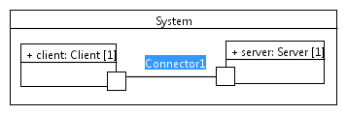
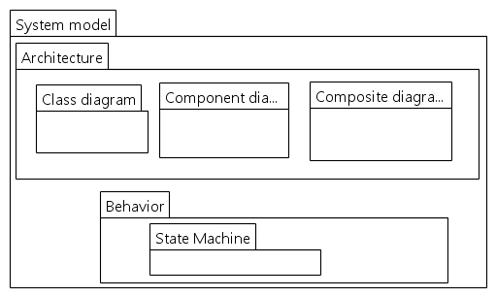
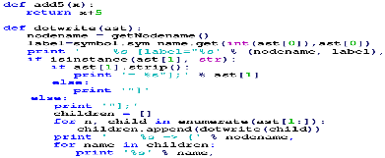
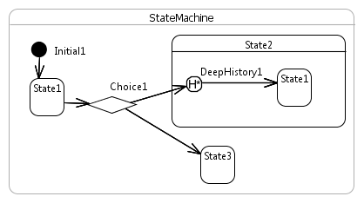
CBSE for event-driven embedded systems
Modeling world
Programming world
Model transformation
Code generation
Synchronization
Reverse engineering

Slide 3
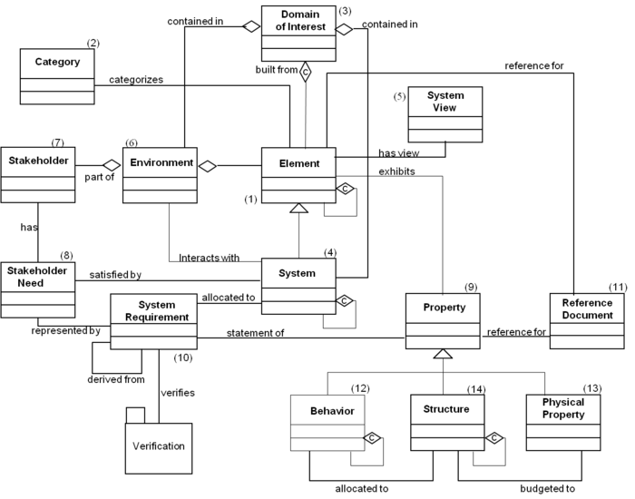
Motivation
Model Driven Engineering (MDE)
Retecence of MDE adoption
Problem understanding
Communication
Code generation
Simulation
Testing
Evolution: Updating models or code?
70 % update models
40 % update code and spend a lot of time to synchronize models and code
Majority of people said that keeping model-code synchronized is critical to the successful use of MDE.
[1]
Automation
Abstraction
Efficiency
Many participants complain about efficiency (memory, performance) of generated code
Semantics of generated code with respect to specification
Complex System
[1] Davide Di Ruscio et al, Model-driven engineering practices in industry: Social,
organizational and managerial factors that lead to success or failure
Notes:
(1 page)
Presents your PhD subject and its context (applicative area, technologies, scientific bootlenecks), what are the scientific motivation and challenges?
Indicates if your research involves collaborating with other labs/teams. If so, present your colleagues and indicates what expertise they bring into your research.
UML and its diagrams (85 %): class, state machine
Domain specific language (39%)
Others: BPMN (24%), SysML (12%)
-Efficient code generation from diagram-based languages for real-time and embedded systems
-Automatic synchronization of models and code

Slide 4
State of the art
CBSE: component, connector, data port (data exchange), control port (interface)
Architecture:
Code generation from component-based architecture model
System is a composite which is described by using composite structure diagram
Connectors between components are static (deterministic at design time)
To some extent (with restrictions), code changes can be propagated to models ➔ consistency issue
Behavior:
Each component’s behavior is specified via UML State Machine for reactive systems
Many tools for code generation from UML State Machine
Modifications made to state machine generated code are not propagated => consistency issue
Consistency issues raised mainly because there is a gap between architecture + behavior
model and code, hence no trivial mapping from models to code

Slide 5
APPROACH IN A NUTSHELL
Model
Intermediate language
OO languages
An intermediate language DCL is proposed for programmers
DCL is generated from model or can be created by programmers
DCL is used for whole system implementation, not just architecture description
DCL adds more constructs to OO languages:
UML State Machine constructs: state, transition, event, pseudo state, action
Component constructs: component, part, port, connector
Reuse maximally existing constructs in OO languages such as class, attribute
DCL is synchronized with models

Slide 6
UML, DCL, OO Mapping
UML | DCL | OO | C++
Class/component | Class | Class | Class
Part | Part | Composition attribute | Attribute
Port (data/control) | Port | Attribute | Reference Attribute
Many ports | Multiple-port | Multiple interface realization | --
Connector | Binding (static+runtime) | -- | Methods
State machine | State machine | Set of classes + methods | --
Provided port constraints (OCL)
Interface | Class/Interface | Interface | Class
Signal | Class | Class | Class/Struct

Slide 7
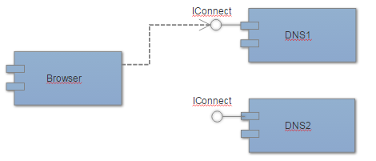
Example: Architecture
class Browser {
port pIConnect {
requires IConnect;
}
}
class DNS1 : public IConnect {
port pIConnect {
provides IConnect;
}
void connect() {
//implementation
}
}
System
class System {
part Browser browser;
part DNS1 dns1;
part DNS2 dns2;
//static configuration
configuration {
bindPorts(browser.pIConnect, dns1.pIConnect);
}
//start system
void run() {
//…
//dynamic change of system connectors
bindPorts(browser.pIConnect, dns2.pIConnect);
}
}
class ICompute {
void connect();
}

Slide 8
Example: Architecture
class DNS1 : public IConnect {
port pIConnect {
provides IConnect;
}
void connect() {
//implementation
}
}
A port can provide or require multiple interfaces/data
For port p of component C
If p provides an interface I => C must implement I or one of C’s sub-com implements
If p requires an interface I => invocations via p (pIConnect -> connect(), e.g.)
If p provides a data signal Sig => C sends signal via p by calling p->sendSig
If p uses a data signal Sig => C/C’s sub-component implements Isig interface, which contains only a method sendSig(Sig& sig);
Two ports p1 and p2 are matches for binding if one of the following cases:
Assemble: All required interfaces of p1 (p2) match with all provided interfaces of p2 (p1) and all provided signals of p1 (p2) match with all required signals of p2 (p1)
Delegation: All required interfaces of p1 (p2) match with all required interfaces of p2 (p1) and all provided signals of p1 (p2) match with all provided signals of p2 (p1)
Match: A match B => A = B or A inherits from B.
class Browser {
port pIConnect {
requires IConnect;
}
}

Slide 9
Example: Architecture
A port can provide or require multiple interfaces/data
DCL
C++
class Browser {
port pIConnect {
requires IConnect1;
requires IConnect2;
}
//call through pIConnect
void test() {
pIConnect->connect1(); //via IConnect1
pIConnect->connect2(); //via IConnect2
}
}
class IConnect1_IConnect2: public IConnect1, IConnect2 {
void connect1();
void connect2();
}
class Browser {
IConnect1_IConnect2* pIConnect;
void test() {
pIConnect->connect1(); //via IConnect1
pIConnect->connect2(); //via IConnect2
}
}

Slide 10
Example: Behavior
System
class Browser {
behavior StateMachine {
//…
}
}

